Slide 1
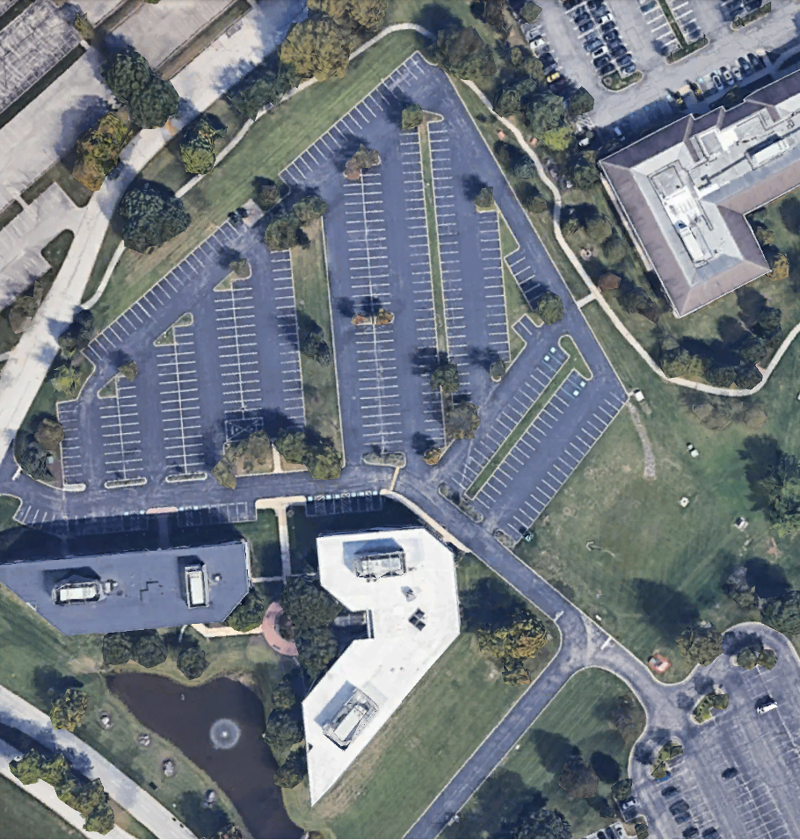



55/65 Valley Stream Parkway
Malvern, PA 19355
Property Overview:
Type: Secure Yard / Industrial
Location: Malvern, PA
Total Area: 3 Acres
Location Details:
The property is ideal for industrial outdoor storage (vehicle and truck parking, construction equipment storage and containers).
Conveniently located for easy access to major transport routes.
Security and Accessibility:
Features:
Well-lit
Secure
Suitable for:
Trucks
Trailers
Tractor Trailers
Containers
Proximity to Major Highways:
Routes 202, 29, 30 & 401
I-476
PA Turnpike
Contact Us
For further information or to schedule
a visit, please email or visit our website.
561-896-9909
info@truckspace.co
www.truckspace.co
Truck Parking Management Solutions

