Slide 1
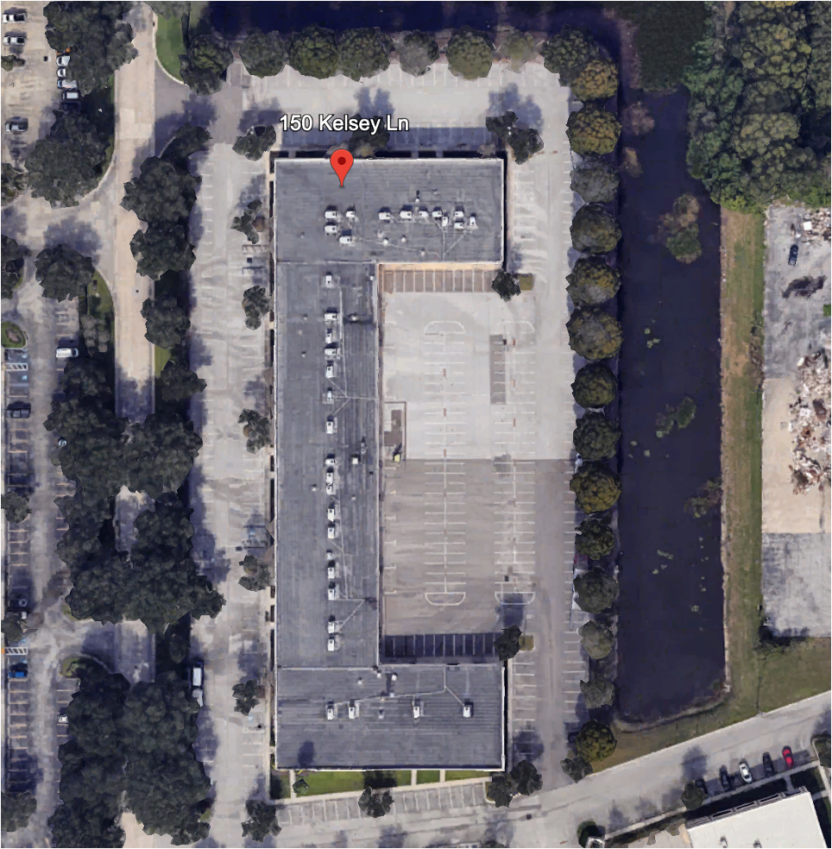



150 Kelsey Lane
Tampa, FL 33619
Property Overview:
Type: Secure Yard / Industrial
Location: Tampa, FL
Total Area: 2.5 Acres
Location Details:
The property is ideal for industrial outdoor storage (vehicle and truck parking, construction equipment storage and containers).
Conveniently located for easy access to major transport routes.
Security and Accessibility:
Features:
Well-lit
Secure
Suitable for:
Trucks
Trailers
Tractor Trailers
Containers
Proximity to Major Highways:
I-75 Corridor
Quick access to US Hwy 301, S I-4
Selmon Expressway
Contact Us
For further information or to schedule
a visit, please email or visit our website.
561-896-9909
info@truckspace.co
www.truckspace.co
Truck Parking Management Solutions

